Slide 1
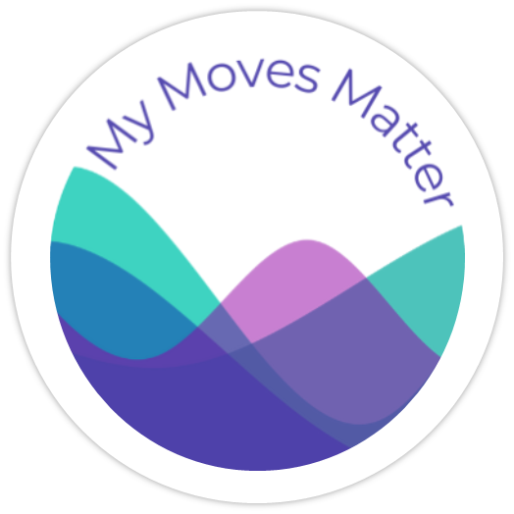

Empowering Parkinson's Care
Multimodal AI for personalized nutrition therapy
My Moves Matter
Richelle Flanagan, CEO; Rene Reinbacher, CTO

Slide 2
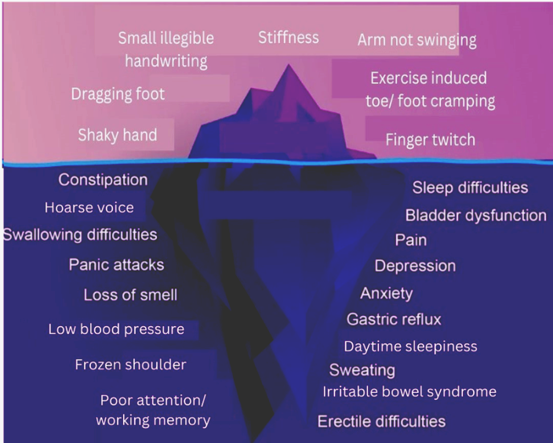
Parkinson's Challenge: A Multi-Faceted Crisis
Nutrition directly affects symptoms & medication response
Social Impact
People with Parkinson’s
Fastest-growing neurological condition: 12M+ people globally. Will outpace Alzheimer’s by 2050.
High economic burden: €25k+ per patient/year (direct + indirect).
Not an ‘old man’s disease’: >40% women; 30% under 60 (> number of people with Multiple Sclerosis).
Access to neurologist: on average 1-2 appointments a year.
Day-to-day variability: Over 40 symptoms fluctuate daily; care needs continuous adjustments. Many are impacted by diet.
Major life impact: 10-20 work years lost, caregiver strain, reduced independence.
Limited Treatment Options
Critical Care Gap
No cure: Medications manage symptoms only, have side effect and have food interactions.
Expensive & invasive therapies: pump therapies, deep brain stimulation.
Complementary therapies: Exercise & nutrition therapy are essential for symptom control & evidence building in slowing progression.
Access Problem: 90% do not have access to dietetic care.
Root Causes: Specialist shortage ( only 2 dietitians per 100k population) and cost prohibitive for private care (~€120+/hr).
Economic case: Strong ROI for medical nutrition therapy (>€60 saved/€1 spent).
Symptoms extend beyond what’s visible in clinic visits.

Slide 3
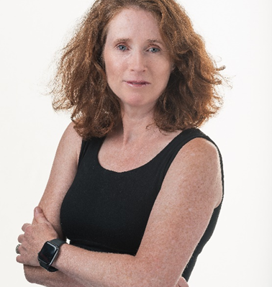
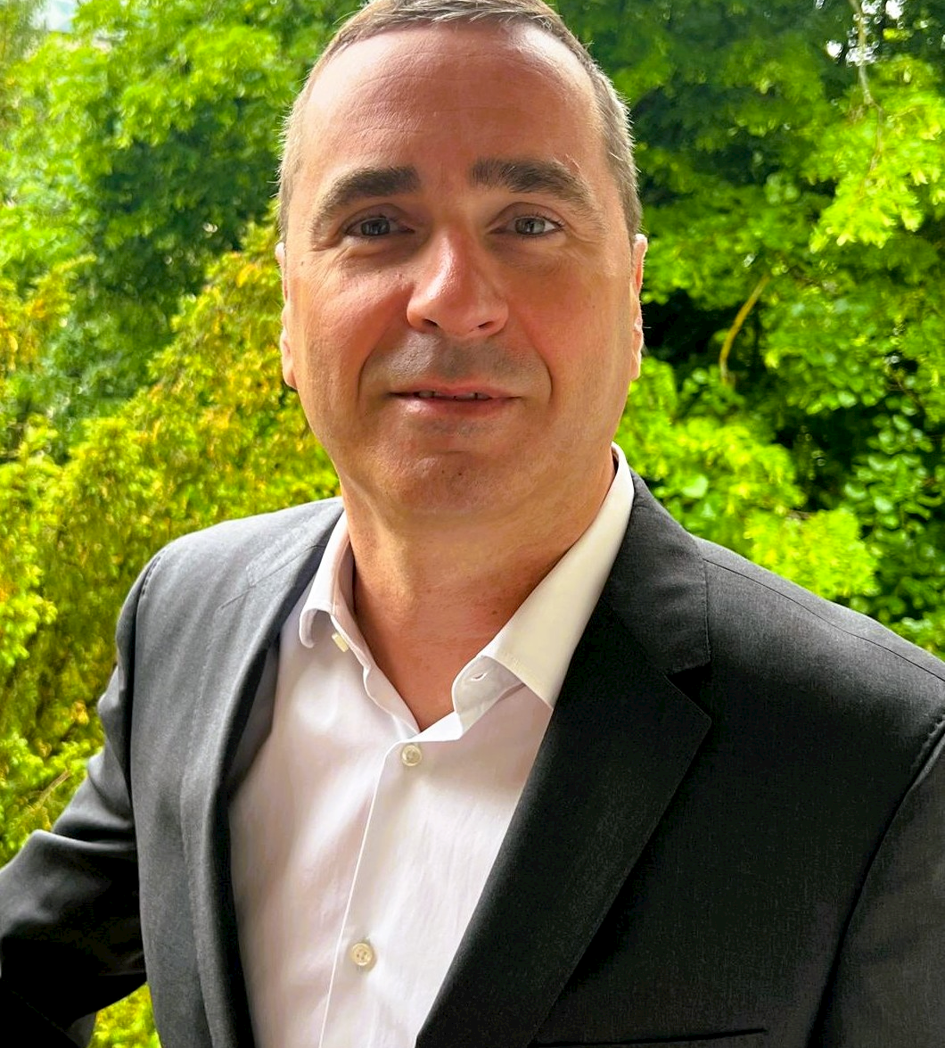
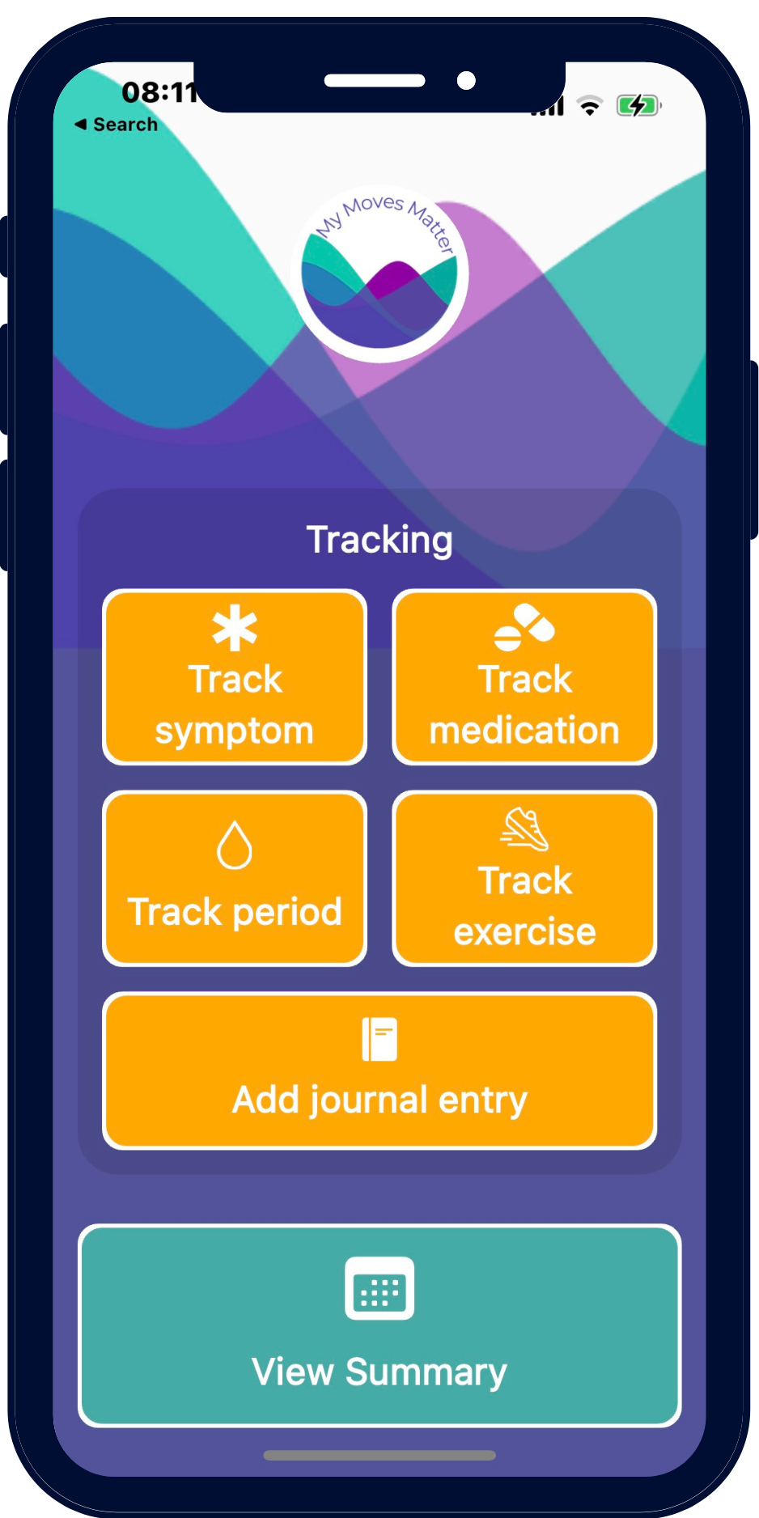
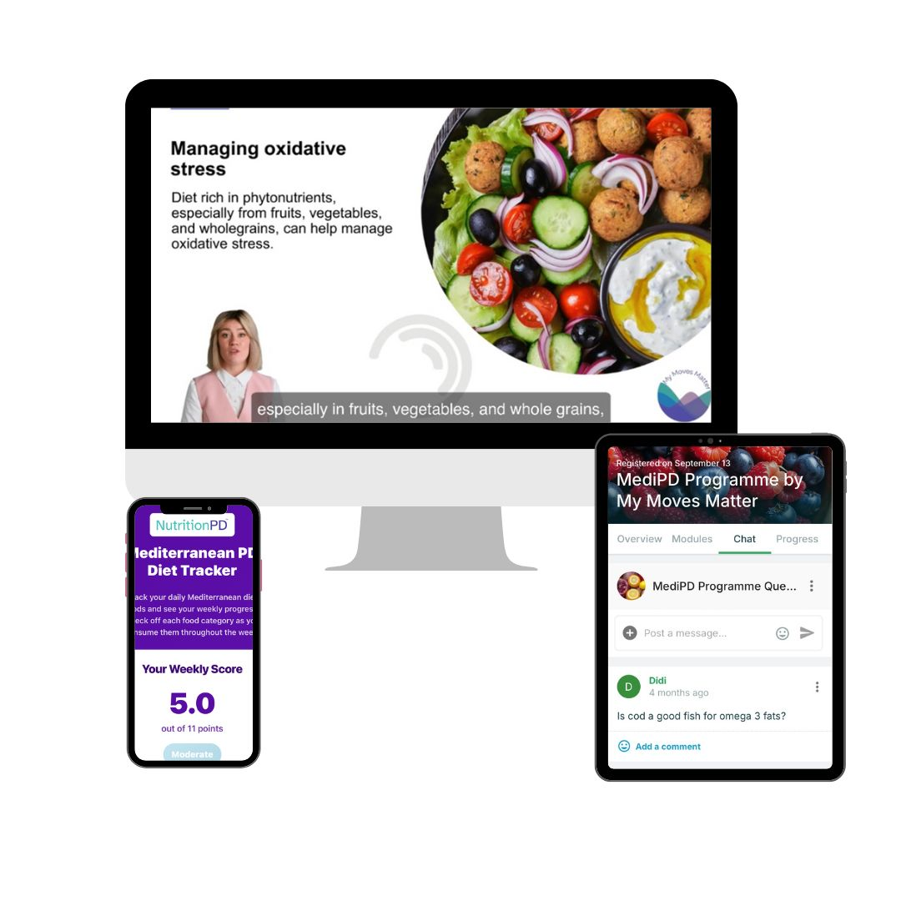
Why Us: Team & Traction
Empowering people with Parkinson’s through building nutrition solutions with the community at the centre
Founded from lived experience and tech expertise
Richelle Flanagan, CEO and Registered Dietitian; health advocate living with Parkinson’s.
Rene Reinbacher. CTO; scientist with extensive industry expertise in AI and data science.
Proven platform and clinical engagement
1,900+ active users on our neuro-friendly app.
Two clinical studies hormonal cycles impact on symptoms with University College Cork; France Parkinson.
UK pilot Nutrition PD online nutrition education programmes: satisfaction 90%, willingness to pay 80%.
Built with the community
Co-designed with the Parkinson’s community for real world usability and impact.
Dietetic supervision; privacy and safety by design.

Slide 4
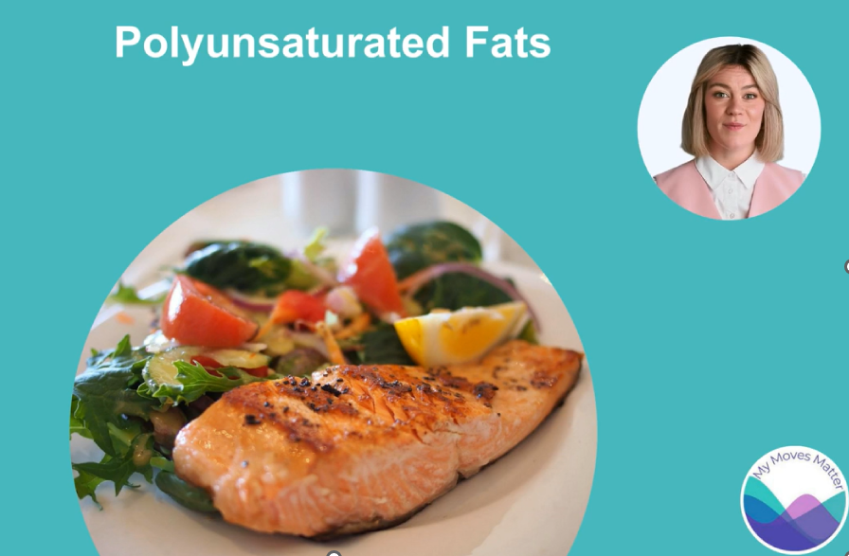
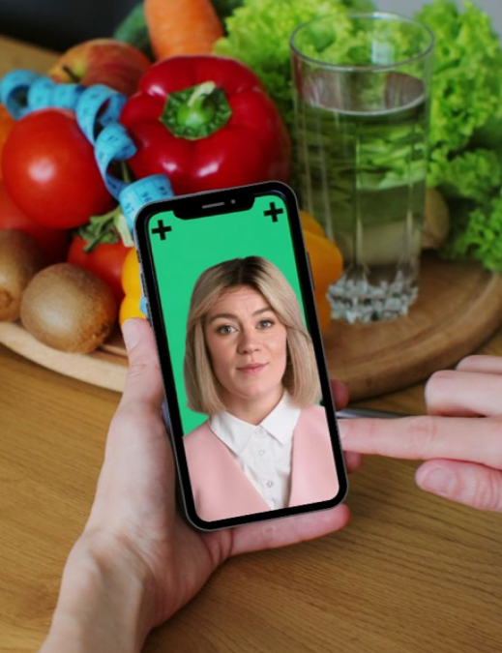
Our Solution: Scalable, Personalized Medical Nutrition Therapy
From education avatars to a generative AI dietitian assistants
Proven Foundation: avatar led education
Validated delivery: Market test pilot with Parkinson’s UK.
Demonstrated outcomes: paying customers, knowledge gains, and strong satisfaction.
Generative AI digital dietitian assistants
Beyond Education: scale nutrition therapy with AI for personalized assessment and planning.
'Digital Dietitian’ Assistants to help deliver scalable, expert care:
  Empathetic AI consultations: utilizing standardized nutrition care process.
  AI-generated planning: drafts personalized plans with dietetic oversight
  Continuous Support: Delivering interactive learning & guidance.

Slide 5
Our Ask: Funding Accessible, Personalized Neurological Care
Raising €500,000 to launch the Digital Dietitian MVP
Use of Funds
Market and business model
Build out Nutrition PD: suite of nutrition education programmes with personalization.
Launch Dietitian Assistant MVP: integrate AI assessment with the avatar led education platform.
Clinical validation: run prospective pilots and real-world use to prove utility.
Acquire users: convert the existing base and new patients to early revenue.
Market snapshot: TAM ≈ € 2.57 B; SAM (UK + IE start, expand to EU/US) ≈ €850 M.
Model: Hybrid B2C and B2B. Consumer subscription; clinic or nonprofit licensing; longer term real world data partnerships.
Validation signals: paying B2C and B2B customers (e.g. Parkinsons UK)
Our Vision
Contact
Extend our AI platform beyond Parkinson’s to additional neurological conditions (for example ADHD and MS).
Become the trusted standard for dietitian supervised, scalable digital neurological nutrition care.
Richelle Flanagan: richelle@mymovesmatter.com
Rene Reinbacher: rene@mymovesmatter.com
Website: https://www.mymovesmatter.com/
Notes:
PoC Objectives: Can AI Conduct a Dietitian Assessment?
Validate GenAI for empathetic, ~1-hour multi-turn assessments (~11 sections) via natural conversation.
Support multimodal input (Voice/Text) & achieve low latency for real-time interaction.
Enable reliable structured data capture in the background.
Core Challenges:
Balancing Conversation & Data: Designing an agent that is conversational and patient-led while simultaneously ensuring thorough and accurate data collection required for clinical forms/assessment.
Ensuring Natural Interaction: Delivering a human-like experience and avoiding a robotic 'chatbot' feel.
Developing Stable Infrastructure: Ensuring flexibility in choice of voice (TTS) and high accuracy/understanding of spoken word (STT).
Key Learnings & Technical Insights:
Orchestration Works: LangGraph + Checkpoints effectively manage complex, stateful conversational flow across multiple turns and logical steps.
Multi-Agent Design Beneficial: Logically separating workflow (Agent 2) from conversation (Agent 1) aided development clarity and complexity management.
Explicit Prompting is Crucial: Modern LLMs require highly specific, refined instructions (System Prompt) for reliable workflow control (e.g., section transitions via tool calls with correct arguments) and accurate data extraction. General instructions are insufficient for precise tasks.
Collaboration Accelerates: PoC developed with AllCloud (AWS Gen AI Partner), leveraging their expertise within our AWS cloud strategy (supported by AWS credits).

